Slide 1
RFP 429-2011 – Design and Construction of the Public Works East Yard Complex at the Former Elmwood/Nairn Landfill Site
AECOM
June 3, 2011

Slide 2

Technical Appendices
- B. Programming and Design Documents
- C. Specifications
- D. Background Information

Slide 3
City of Winnipeg
Public Works East Yards Design Build RFP
Public Works Divisions
  Bridge Operations Division (BO)
  Centralized Parks Services Division (CS)
  East Area Parks, Parks and Open Spaces Division (EA)
  Streets Maintenance Division – East Area (SM)
Winnipeg Fleet Management Agency (FM)
  Base building (separate price option)
Terminology:
  Contract Administrator = City of Winnipeg
  Design Build Team = design build proponent, including consultants
  Consultant = Design Build Team’s Architect or Engineer of Record

Slide 4
Appendix B. Programming and Design Documents
Appendix B1 – Basic Program of Requirements
  Related Drawings and Specifications
  Building and Site Design Considerations
  Overall Space Summary – building and site areas
  Detailed Descriptions of Functional Spaces
Appendix B2 – Room Data Sheets
Appendix B3 – Furnishings Table
  for Space-Planning Purposes only
Appendix B4 – Schematic Drawings - Building and Site

Slide 5
Appendix B. Programming and Design Documents
B4.1 SITE DRAWINGS
01-C-1001 Subject Site – Existing Conditions
01-C-1002 Summary Diagram of Subsurface Investigations
01-C-1003 Conceptual Site Plan – Program Elements
01-C-1004 Conceptual Site Plan and Details – Surfacing Materials
01-C-1005 Conceptual Site Servicing Plan and Details
01-C-4001 Gate Details

Slide 6
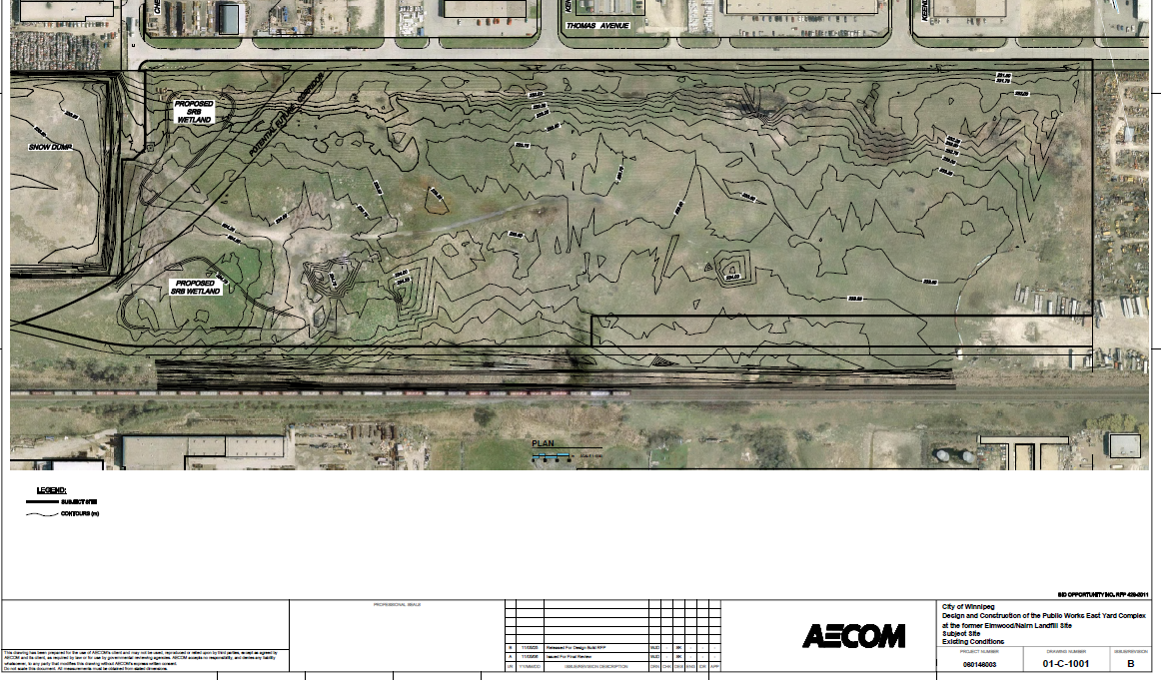
01-C-1001 Subject Site – Existing Conditions
Context, 0.25 m ASL contours, existing features

Slide 7
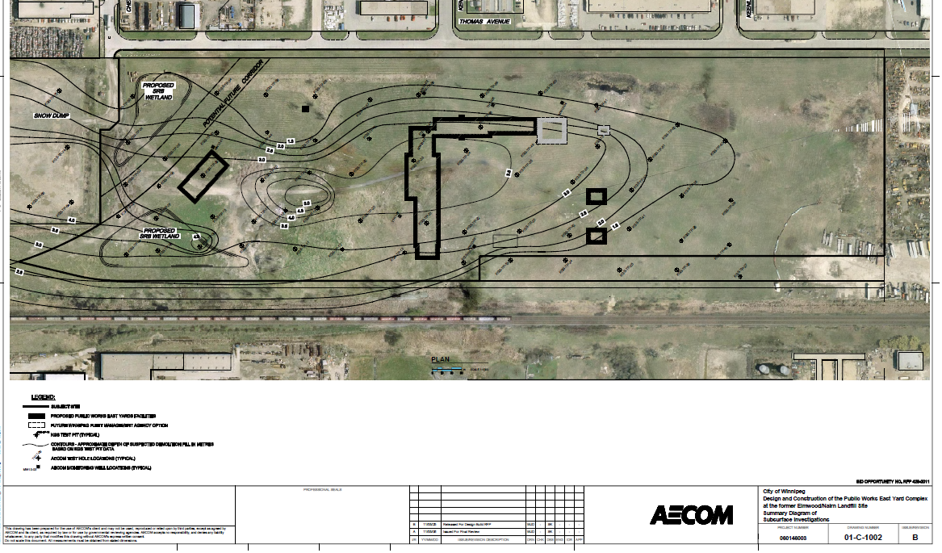
01-C-1002 Summary Diagram of Subsurface Investigations
Contours indicate depths to undisturbed material.

Slide 8
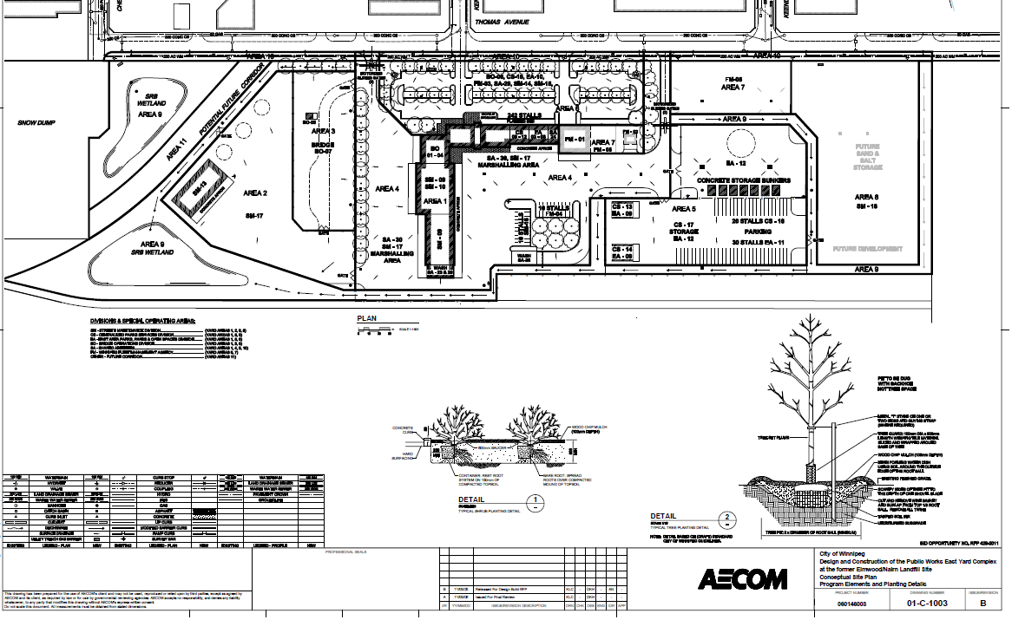
01-C-1003 Conceptual Site Plan – Program Elements
Organizing diagram referencing Program of Requirements

Slide 9
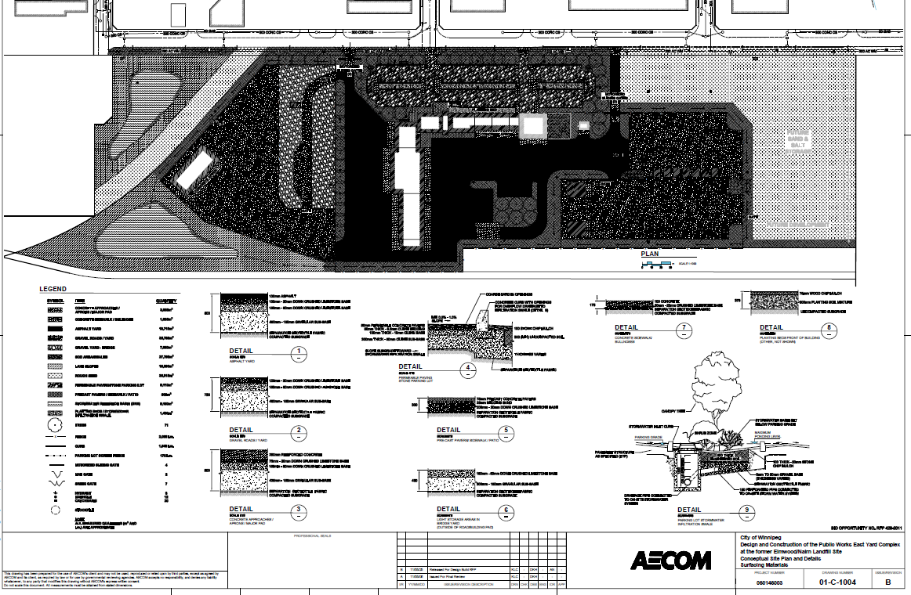
01-C-1004 Conceptual Site Plan and Details –
Surfacing Materials

Slide 10
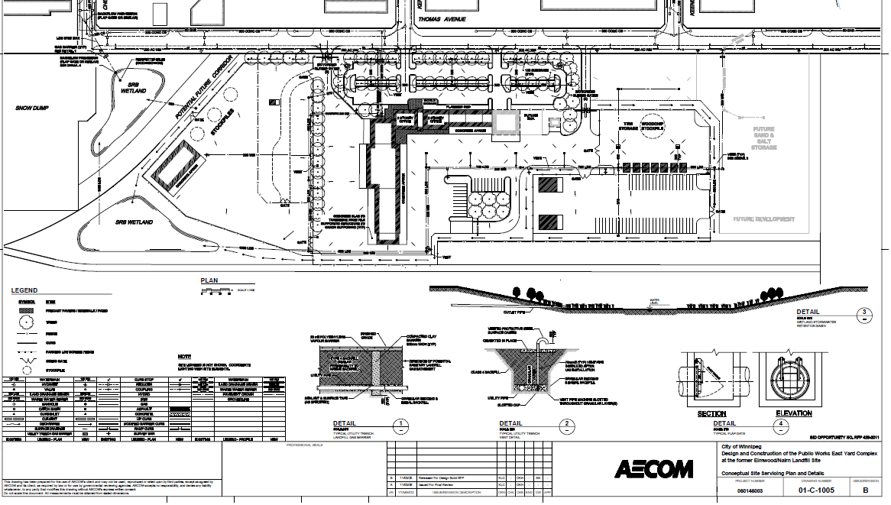
01-C-1005 Conceptual Site Servicing Plan and Details
Water, wastewater, land drainage, with gas venting details

Slide 11
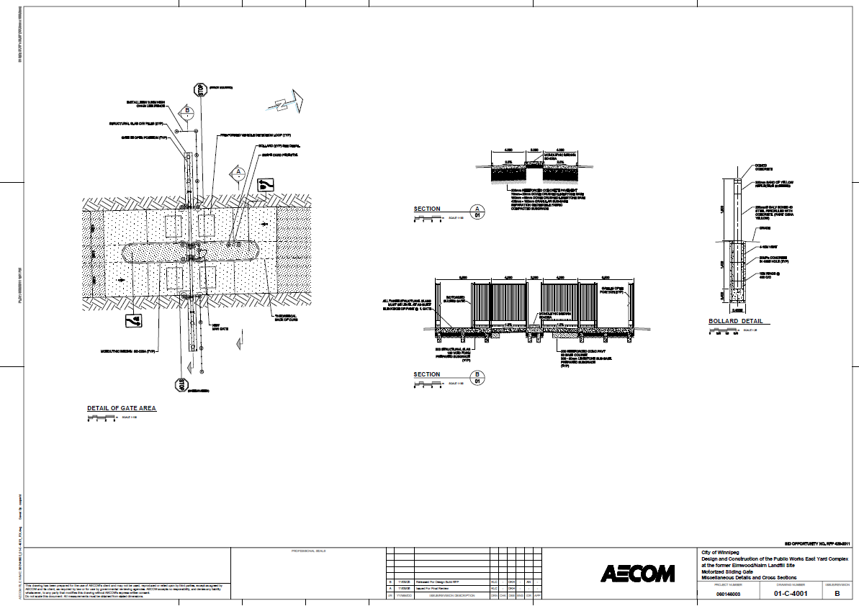
01-C-4001 Gate Details
City’s preferred access control gate (WTP)

Slide 12
Appendix B. Programming and Design Documents
B4.2 BUILDING DRAWINGS
A-1 Main Office and Garage Building Schematic Design Drawing - Floor Plans
A-2 Main Office and Garage Building Schematic Design Diagram - Main Floor
A-3 Main Office and Garage Building Schematic Design Diagram - Second Floor
A-4 Main Office and Garage Building Schematic Design Diagram - Roof Plan
A-5 Main Office and Garage Building Schematic Design Diagram - Building Elevations
A-6 Main Office and Garage Building Schematic Design Diagram - Building Sections

Slide 13
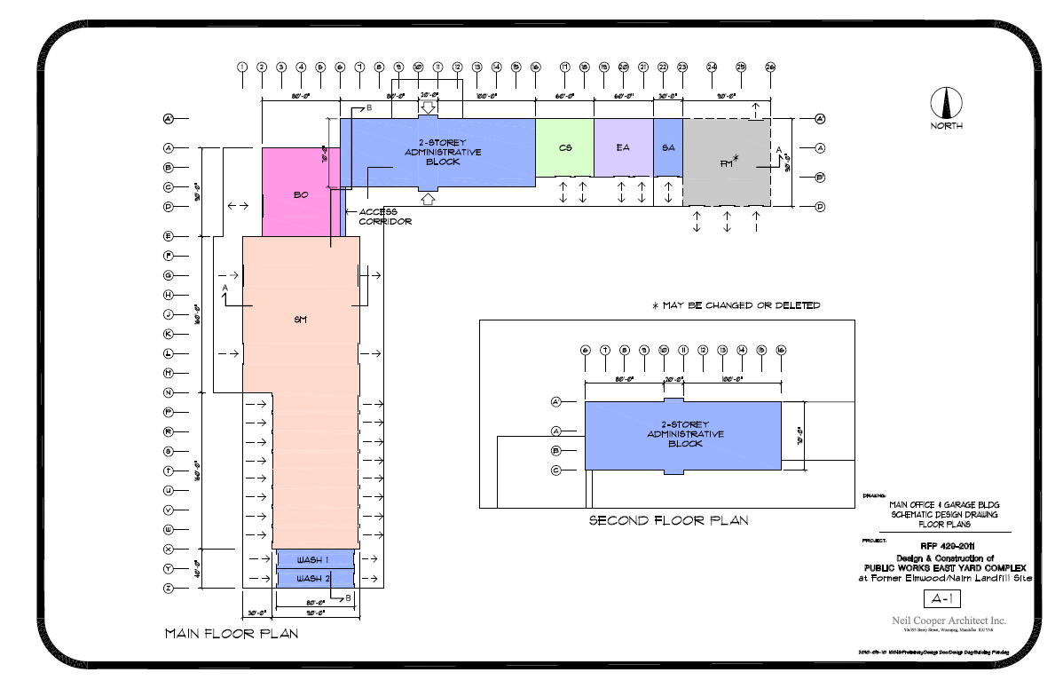
A-1 Main Office and Garage Building Schematic Design Drawing - Floor Plans

Slide 14
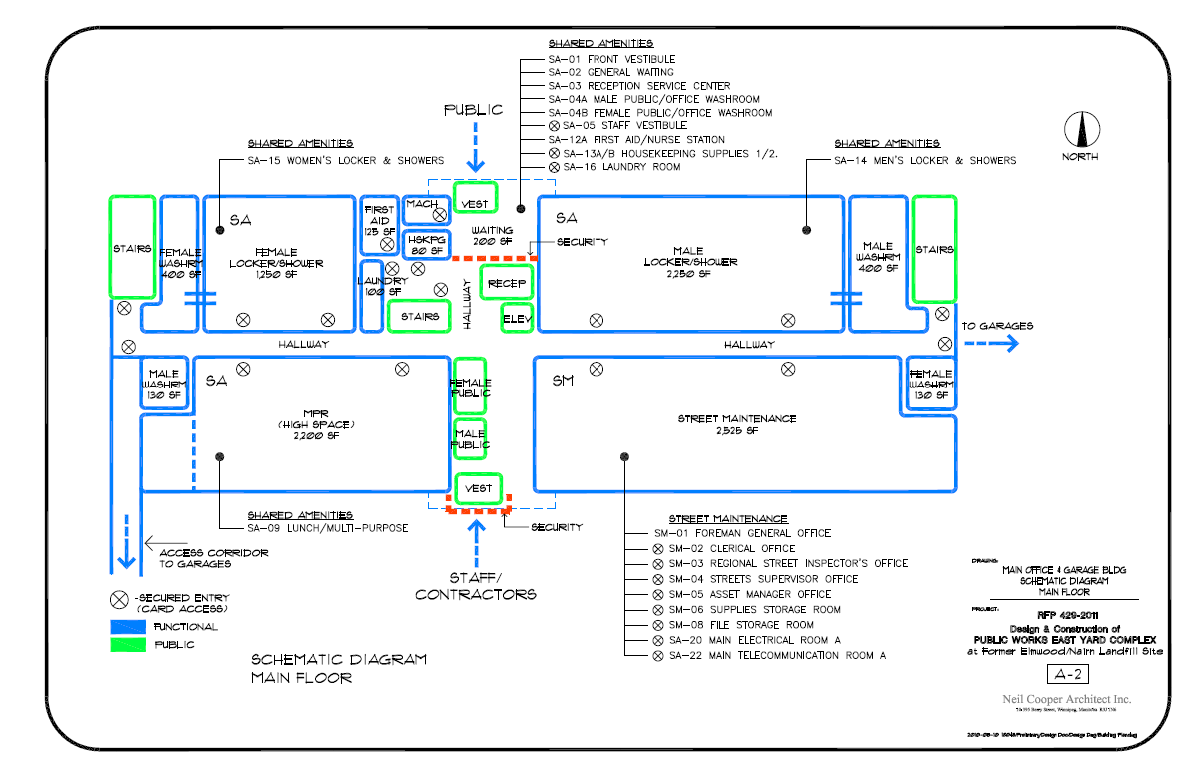
A-2 Main Office and Garage Building Schematic Design Diagram - Main Floor
Mechanical, electrical and telecommunications are in gross up

Slide 15
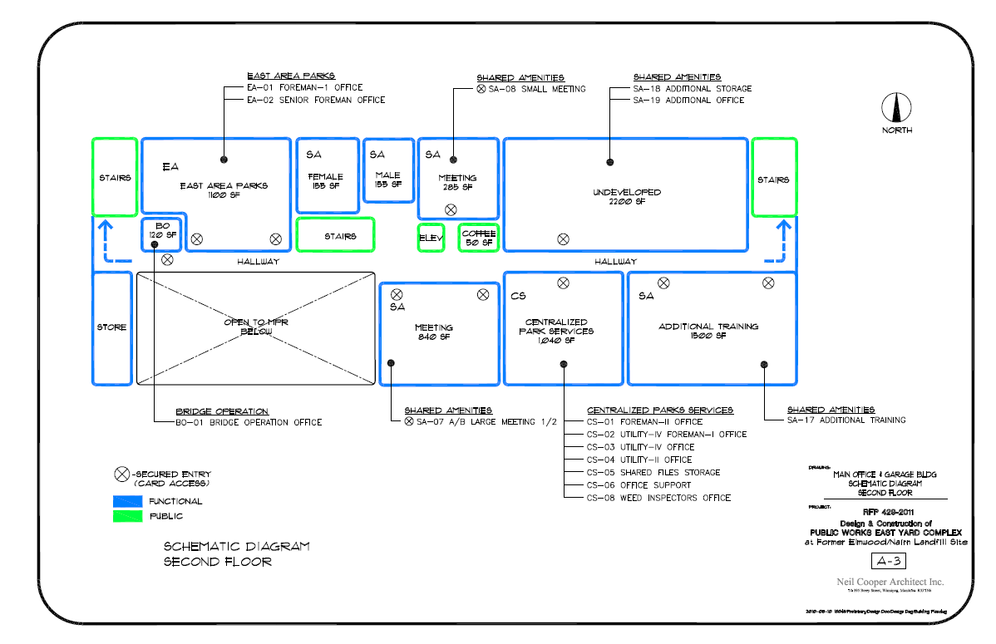
A-3 Main Office and Garage Building Schematic Design Diagram - Second Floor
Additional Office and Storage are unfinished spaces

Slide 16
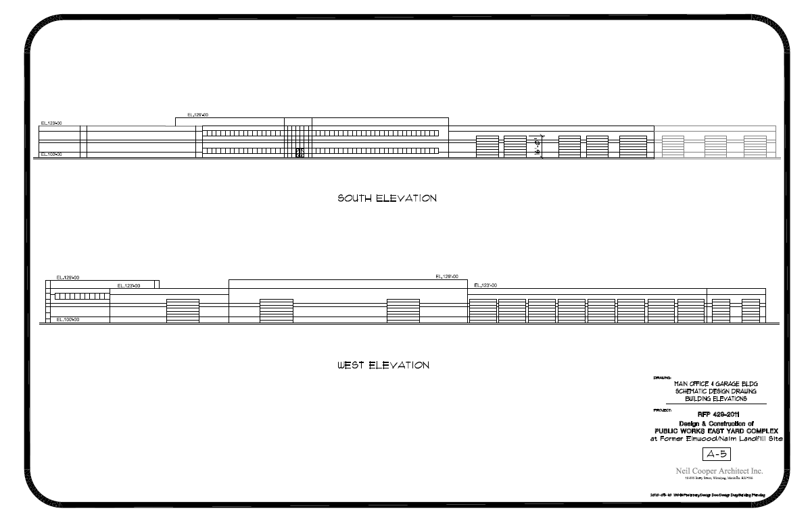
A-5 Main Office and Garage Building Schematic Design Diagram - Building Elevations

Slide 17
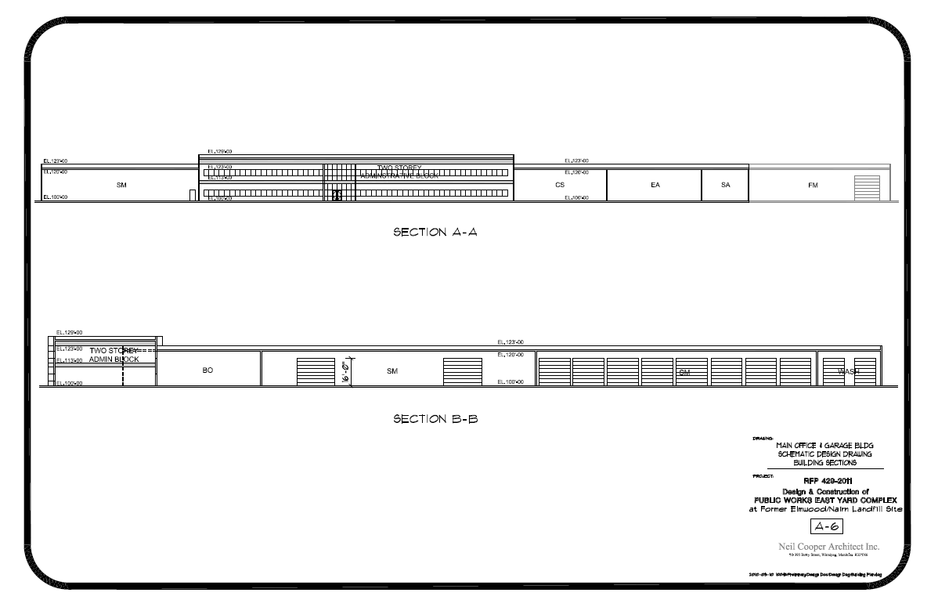
A-6 Main Office and Garage Building Schematic Design Diagram - Building Sections
WFMA is shell only

Slide 18
Appendix C. Specifications
Appendix C1 – Outline Specifications – NMS referencing the City of Winnipeg Standard Construction Specifications
Appendix C2 – LEED® Requirements
  .1 Table C2-1: LEED® Canada-NC 1.0 Project Checklist
  .2 Table C2-2: Potential LEED® Strategies
Appendix C3 – MET-Rate Activity Summary Table
Appendix C4 – Hazardous Material Storage Summary Table
Appendix C5 – Equipment Summary Table

Slide 19
Appendix C. Specifications
Appendix C6 – City of Winnipeg Access Control and Intrusion Detection Requirements
  .1 Figure C6: Block Diagram - Access Control and Intrusion Detection
Appendix C7 - Figure C7: Schematic Plan for Streets Maintenance Heated Vehicle and Equipment Storage (SM-09)
Appendix C8 – Figure C8: Conceptual Plans for Bridge Operations Yard Building (BO-07)
Appendix C9 – Bridge Operations Crane Truck

Slide 20
Appendix D. Background Information
Appendix D1 – Public Works East Yards – Geotechnical Investigation
Appendix D2 – Public Works East Yards – Methane Gas Monitoring
Appendix D3 – Public Works East Yards Relocation – Traffic Impact Assessment
Appendix D4 – Former Elmwood / Nairn Landfill Site Final Preliminary Site Condition Assessment Report (KGS Group)

Slide 21
Appendix D. Background Information
Appendix D5 – Standards and Guidelines for the Mitigation of Methane Gas at Buildings and Utilities - and – Guidelines for Construction on Landfill Sites, City of Winnipeg, Dec. 2006
Appendix D6 – Land Titles
Appendix D7 – Plan of Survey - Snow Dump Site

Slide 22
Building and Site
Design Considerations

Slide 23
Building and Site Design Considerations
Building Area - 9,810.8 sm (105,607 sf) Gross
  Administrative Component 2,142.7 sm (23,065 sf)
  Heated Garage, Storage, Shop Component 5,541.6 sm (59,602 sf)
  Unheated Garage, Storage Component 2,126.5 sm (22,890 sf)
  Fleet (included in totals above) 853.1 sm (10,260 sf)
Site Area – 10.3 ha (25.6 acres) - Developed
  Exterior Yard and Storage 75,645 sm (814,262 sf)
  Sod 27,795 sm (299,193 sf)
  Stormwater Retention and Swales 26,970 sm (290,312 sf)
  Future Development (incl. Sand & Salt ) 36,815 sm (396,286 sf)
  Fleet (included in totals above) 9,383 sm (101,005 sf)
    Note: all areas are approximate and include gross up factors

Slide 24
Building and Site Design Considerations
Former Landfill
  Buried organic material in adjacent areas
    Localized detectable levels of methane gas (in the past)
  Landfill gas generation may continue indefinitely
  See relevant documents in Appendix D
Landfill Gas Migration and Venting
  Buildings shall comply with “City of Winnipeg Policy for Building on Landfill Sites” (1984), or the “Policy for Building on Nairn-Elmwood Landfill Sites” (Appendix D5)
  Gas concentrations within the site shall not exceed regulated levels
  Use passive control systems along underground services and utilities trenches (create natural pressure gradients to vent gas)
  Use combination of under-slab venting (active systems) and low-permeability barriers in enclosed structures to prevent gas accumulation and migration

Slide 25
Building and Site Design Considerations
Landfill Gas Migration and Venting
  Install permanent gas monitors with alarm systems to warn of hazardous landfill gas concentrations
  Test monitoring equipment semi-annually
  No accessible crawl space
Geotechnical
  Review Summary Diagram of Subsurface Investigations (Drawing 01-C-1002, Appendix B4)
    Contours indicate depths to undisturbed material
  Conduct independent assessment, and additional geotechnical investigations to verify the subsurface conditions

Slide 26
Building and Site Design Considerations
Structural
  Shallow foundations on fill material are not acceptable
  Design and construct facility in accordance with the NBCC, Part 4, Post-Disaster Importance Category
  Incorporate durability requirements - LEED®
  Consider maximum loaded vehicle weights in design of building aprons, grade beams, and garage and shop floors
  Concrete aprons in front of overhead doors to be transition slabs

Slide 27
Building and Site Design Considerations
LEED® Silver Certification
  In accordance with the Canadian Green Building Council (CaGBC) LEED® Canada-NC, Version 1.0 Rating System
  Apply for a minimum of 36 credits (+4) - LEED® Canada-NC 1.0 Project Checklist
  Mandatory, recommended and discretionary credits discussed - Potential LEED® Strategies
  “Not Recommended” used to identify undesirable credits - based on difficulty to achieve for this project

Slide 28
Building and Site Design Considerations
Architectural Design
  General Building Design
    Two-storey Administrative and Staff component
    Single storey, high ceiling Heated Garage, Shop and Storage component
    Separate, detached, Unheated Garage and Storage buildings
  General Codes and Regulations
    National Codes and Manitoba Regulations – Building, Plumbing, Fire
    City of Winnipeg Access Guide to Universal Design
  Requirements for Different Spatial Types – Basic Program of Requirements and Room Data Sheets
    Flooring and base, walls, ceilings,
    Man doors, overhead doors, lighting, windows, audio-visual

Slide 29
Building and Site Design Considerations
Architectural Design
  Thomas Avenue Façade –
    Wall plane articulation/variable parapet
  Building Entryway Design – highly visible entry
    City of Winnipeg Zoning By-law No. 200/2006, Part 5: Development and Design Standards
  Herbicide and Pesticide Storage
    Adhere to health and safety requirements
    Requires smaller heated space (to 5 degrees C)

Slide 30
Building and Site Design Considerations
Baseline Security Requirements
  Main Office, Shop, Garage and Storage Building
    Mandatory Card Access security points
    Lock sets - other spaces
    Secure area for SM dedicated colour copier
    CCTV monitoring of public areas, including upstairs meeting rooms
  Unheated Garage and Storage Buildings
    Lock sets
  Site
    3.05 m perimeter fencing /2.44 m interior fencing
    Main entrances
      Two-way motorized sliding gates with Card Access and remote control
      Pedestrian gates with Card Access
    Secondary access points in yard areas – lock sets
    CCTV coverage – particularly of gates and building entrances

Slide 31
Building and Site Design Considerations
Mechanical
  General Mechanical – Federal and Provincial Codes and Regulations
  Mechanical Room
    Centrally located penthouse or two-storey space for major mechanical components
    Tempered environment, internal access and internal ducting
  Rainwater/Meltwater Collection, Storage and Reuse
    Roof-top collection of rain water and snow melt for use in wash bays
    Wash bay water treated to stormwater quality and returned to cistern
  Plumbing Fixtures
    All toilets shall have automatic flush mechanisms
  HVAC Systems
    Design to reduce energy requirements below the baselines in ASHRAE 90.1-2007 or Model National Energy Code for Buildings 1997 energy efficiency requirements

Slide 32
Building and Site Design Considerations
Electrical and Telecommunications
  Potential for Electrical Servicing
    600 volt, 3-phase power readily available
  Electrical and Telecommunications Rooms
    Main rooms in two-storey Administrative and Staff office area
    Satellite rooms in East Area Parks, and central to Streets Maintenance Heated Garage and Storage areas
  Backup Power
    Emergency power generator
      24 hours for entire facility
      72 hours for SM heated building components; SA Administrative & Office components; main entry gates and marshalling areas
  Site Lighting - different poles and fixtures in Parking and Yard areas
  Power Smart Rebates
    Investigate and obtain rebates for the City of Winnipeg
  Provide raceways for future development (east)

Slide 33
Building and Site Design Considerations
  Telephone and Cable Servicing
    Available
Site Design
  Employee and Visitor Parking
    242 stalls, 151 with electrical receptacles; 91 un-serviced - 2.7 m X 6.1 m stalls
    7 larger accessible stalls, serviced
  Vehicle and Equipment Storage and Movements
    70 Yard parking stalls, all with electrical receptacles - 3.3 m x 15.3 m
    Design Yard areas for turning radii of the largest vehicles/equipment
  Bicycle Storage Requirements
    5% of building users; covered and secure
  Site furnishings –
    Amenities - minimum distances from main building for smokers

Slide 34
Building and Site Design Considerations
Site Design
  Site Signage
    City of Winnipeg Zoning By-law No. 200/2006, Part 5: Development and Design Standards – Signs
    Wayfinding signage system to provide clear direction to employees, visitors and contractors entering the site
  Yard Construction
    typical cross-sections on the Conceptual Site Plan - Surfacing Materials drawing (Drawing 01-C-1004)

Slide 35
Building and Site Design Considerations
Site Servicing
  Water Servicing and Fire Protection
    200mm loop tying into Thomas Avenue watermain
    Hydrant locations are based on the City’s min. hydrant coverage of 76 m spacing; 8 additional hydrants required in rear lot areas
    Fire flow requirements potentially exceed available fire flows unless additional precautions are taken, such as careful selection of building materials and fire separations, or incorporation of an automatic sprinkler system into the Main Office, Shop, Garage, and Storage building
  Wastewater Servicing
    Full-time and seasonal staff complement of 242 people includes 9 for WFMA, which would increase with a larger Shop and Office facility
    Accommodated by a 200MM wastewater service connection to existing combined sewer system east of Kent Street
    Calculate using Fixture Unit Method

Slide 36
Building and Site Design Considerations
Site Servicing
  Stormwater Management
    Roland Combined Sewer District - underutilized 1500mm trunk located parallel to and north of Thomas Avenue
    Restrict drainage to pre-development rates (grassland)
    Incorporate on-site stormwater detention
  Land Drainage System Connection
    Double-backflow prevention, double flap gate
    Hickenbottom Surface Inlet device within the downstream (Snow Dump) retention basin
    Inlet shall be set well above the invert of the existing combined sewer system
  On-site Detention
    10.1 ha (25 acre) service area
    0.74 ha (1.82 acres) of live storage (7.3% of total)

Slide 37
Building and Site Design Considerations
Site Servicing
  Constructed Wetland Stormwater Detention Basins
    Snow Dump and vehicle wash discharge with high dissolved salt content
    Use salt-tolerant seed mixture
  Site Grading
    Drainage arrows on drawings
    Maximize use of swales and infiltration trenches
  Potential for Natural Gas Servicing
    Readily available, not cost for installation

Slide 38
Design Build Bid

Slide 39
Use of Digital Materials
Digital Materials
  The City intends to provide (by Addendum) the plans and specifications listed in Appendices B and C, in digital format (AutoCAD and Word) for use by the Design Build Teams
  All AECOM logos /identifiers will be removed
  Design Build Teams will be responsible for the accuracy of drawings and specifications submitted with their Proposals

Slide 40
Thank You.
Questions?
Shaun.Klassen@aecom.com

